Slide 1
Perfecto Automation with Quantum Smart Reporting

Slide 2
Agenda
1
Introduction
2
The Reporting Views
3
Tagging
4
Questions?

Slide 3
Introduction

Slide 4
Smart Reporting
Perfecto’s reporting app contains much more than just viewing the script execution.
The Reporting views allow you to view your project’s health by multiple criteria
CI Jobs
Tags
Devices – includes physical devices, OS versions and more
Tests running across devices

Slide 5
Smart Reporting – the different views
Let’s go in and look at the different views provided:
Report Library
CI Dashboard
Heatmap
Live Stream

Slide 6
Reporting Views

Slide 7
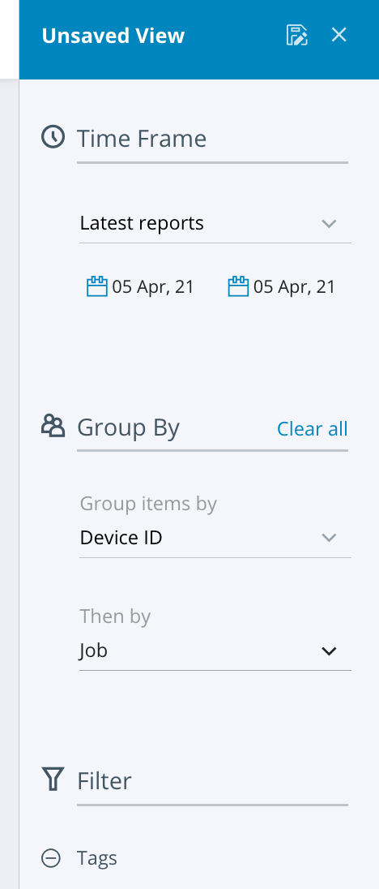
Report Library
Lists all the tests that were run on the cloud
View is configurable – allows filtering by dates, devices, jobs, tags and more.
Views can be saved and shared

Slide 8
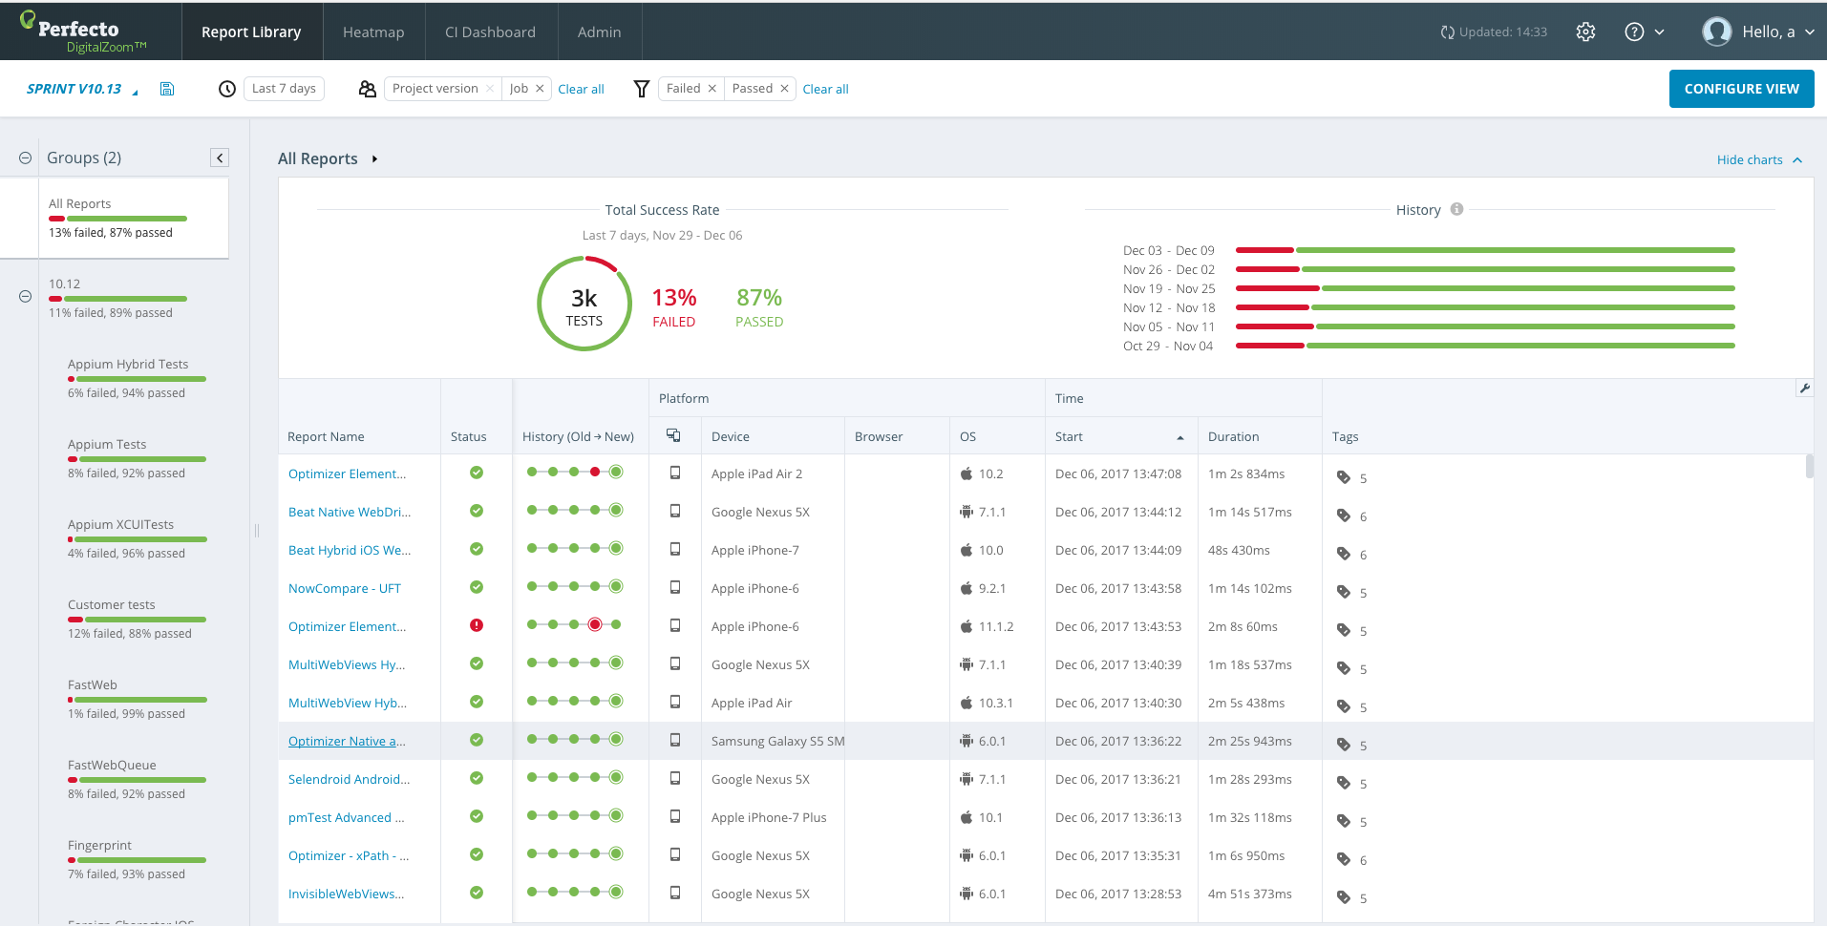
Reports Library - Testing at scale and drill down on specific quality areas
Notes:
The reports library shows a list of executions. Each execution can be opened and viewed.
The view in the library is configurable, dates, platforms, tags, devices and more can be changed to give the ideal view for what you need.
It is possible to save multiple views as well.

Slide 9
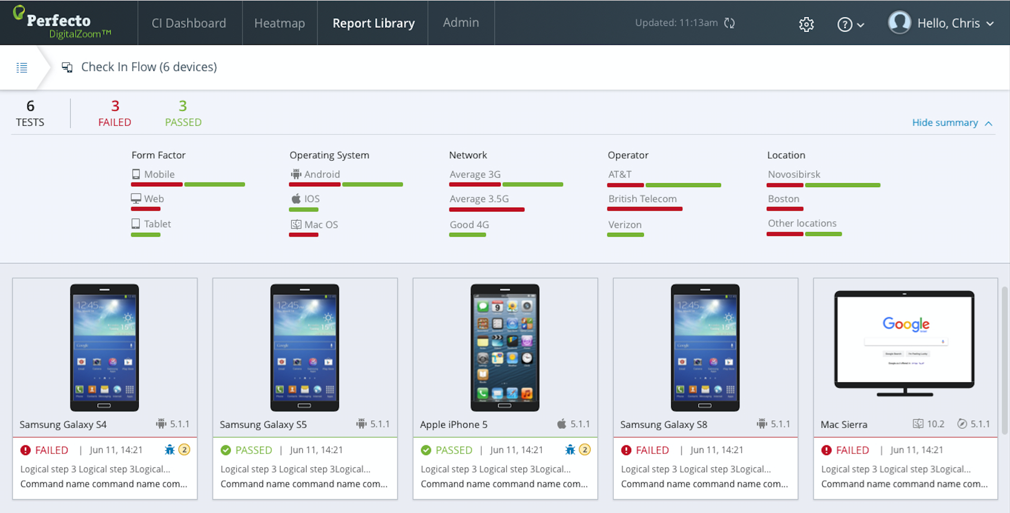
Notes:
By grouping & focusing on the criteria you are interested in you can generate custom views that tell you at a glance where problems are located.
We’ll now go into the reporting application and look at the report library in action.
Open the reporting library and create a custom view with:
Dates
Success criteria
Group by with levels
Form Factor

Slide 10
CI Dashboard
Tests run from CI appear in this view
Track your tests by Job
Constantly updated view of success/fail and performance over time
An ideal view for troubleshooting

Slide 11
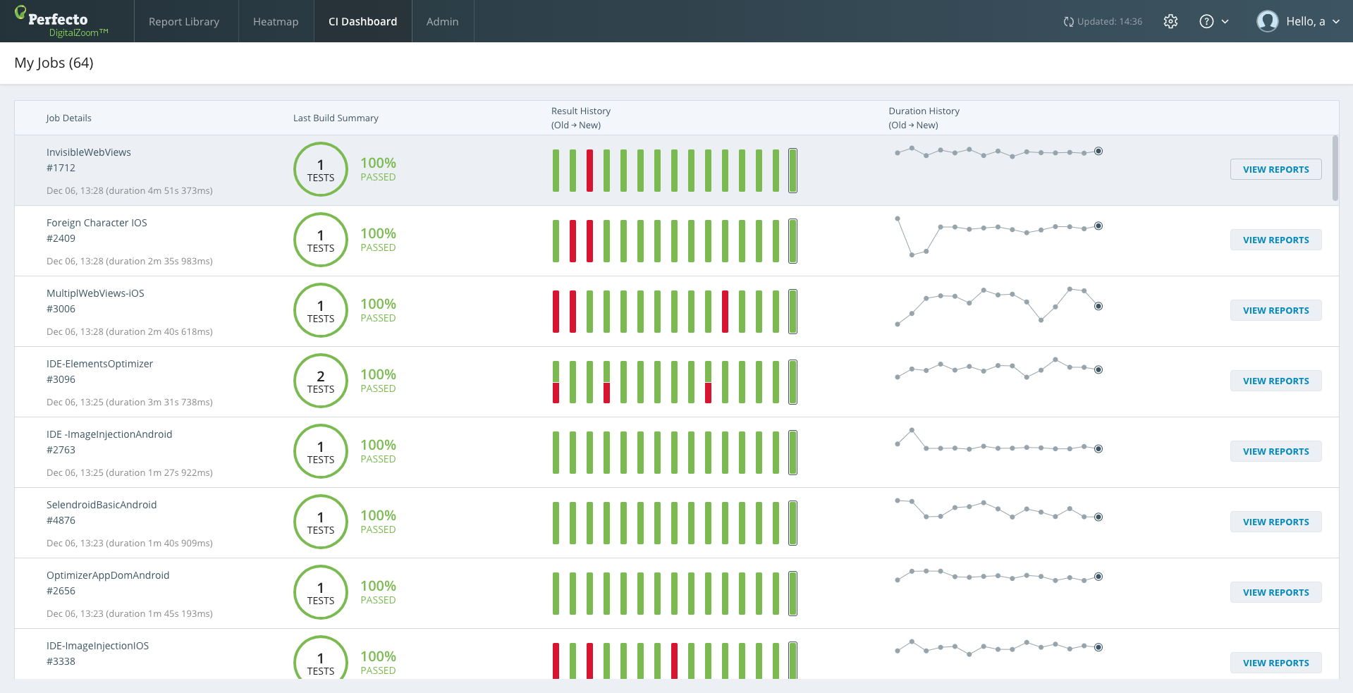
CI Dashboard – Fast feedback for Continuous Integration users: get instant build quality visibility
The CI Dashboard delivers a historical view of test suite results. The primary user of the view is management to understand overall quality trending.
Notes:
The CI dashboard is another view which looks at results per job over time.
This is a useful metric to validate specific jobs are running as expected and over time provides valuable insight over performance & quality.

Slide 12
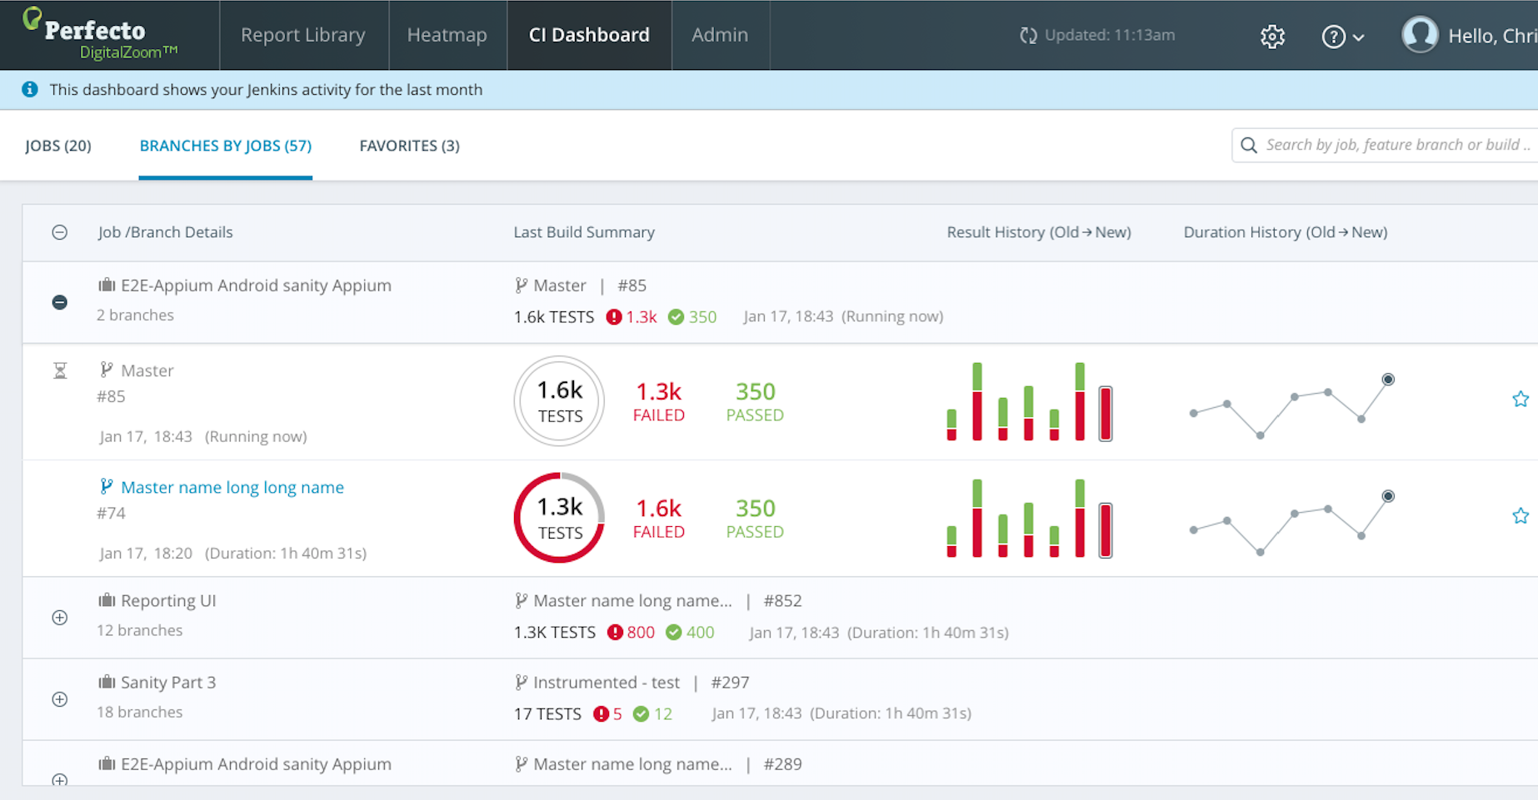
CI Dashboard – Enjoy Pipeline Quality visibility across different Feature Branches

Slide 13
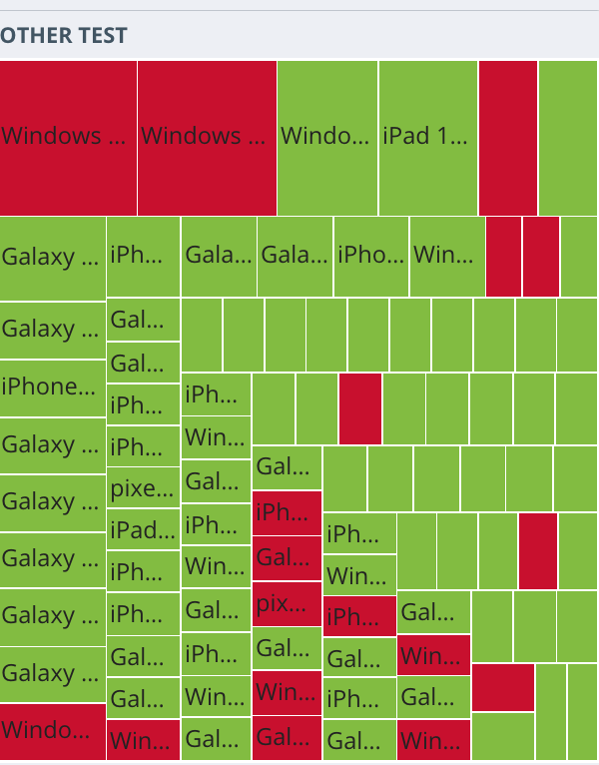
HeatMap
The heatmap provides a view of all your tests, according to different devices.
Provides a visual cue on how tests run across devices
Click directly on areas of interest to access reports

Slide 14
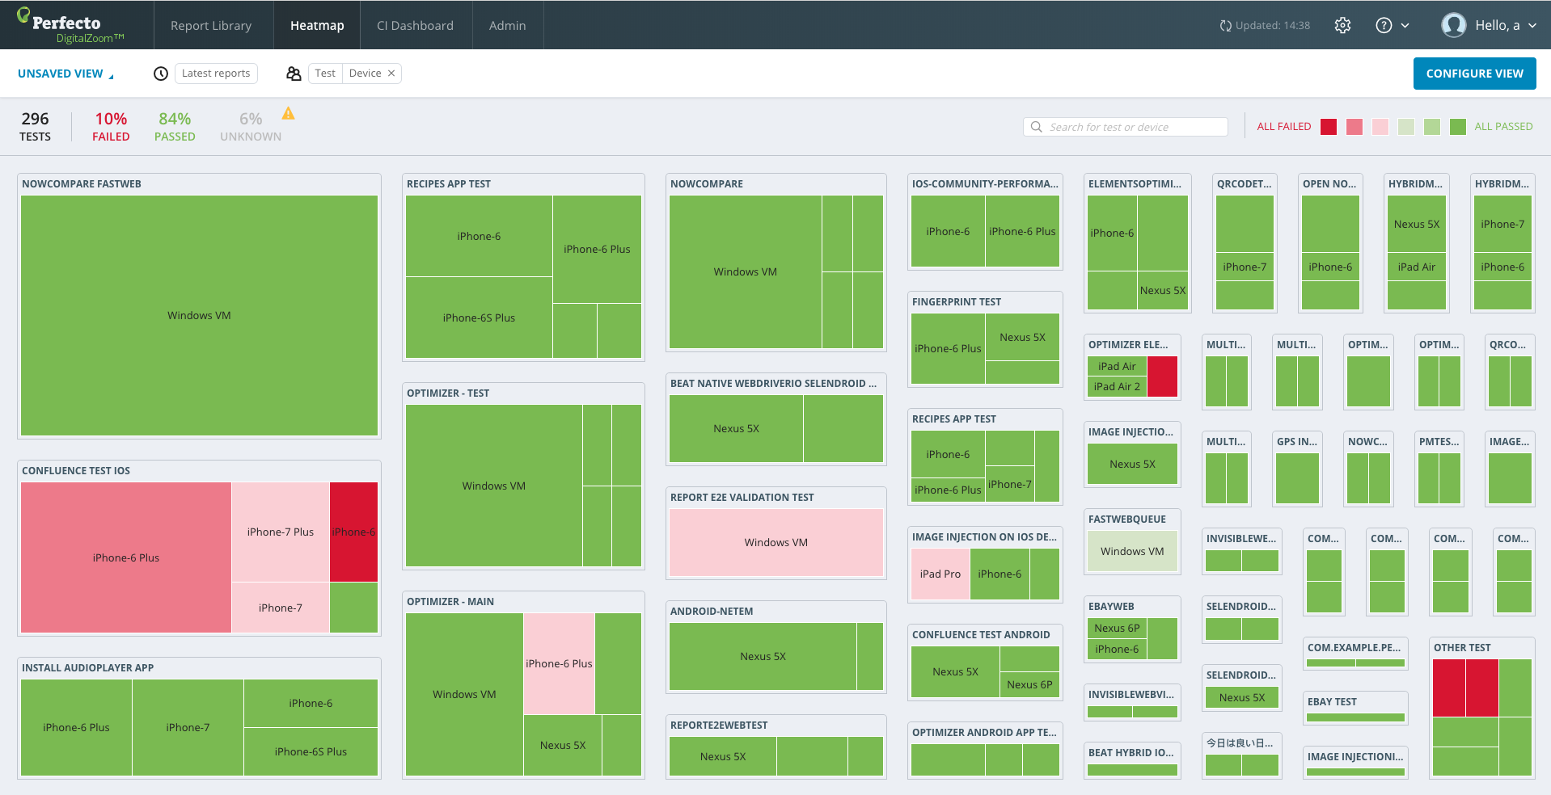
Heatmap Dashboard – Executive/team level quality assessment
Notes:
The Heatmap shows the same information in the report library i.e. executions & status, with an added element of visually slicing the data into tests & devices.
This enables an instant understanding of where the app is failing.

Slide 15
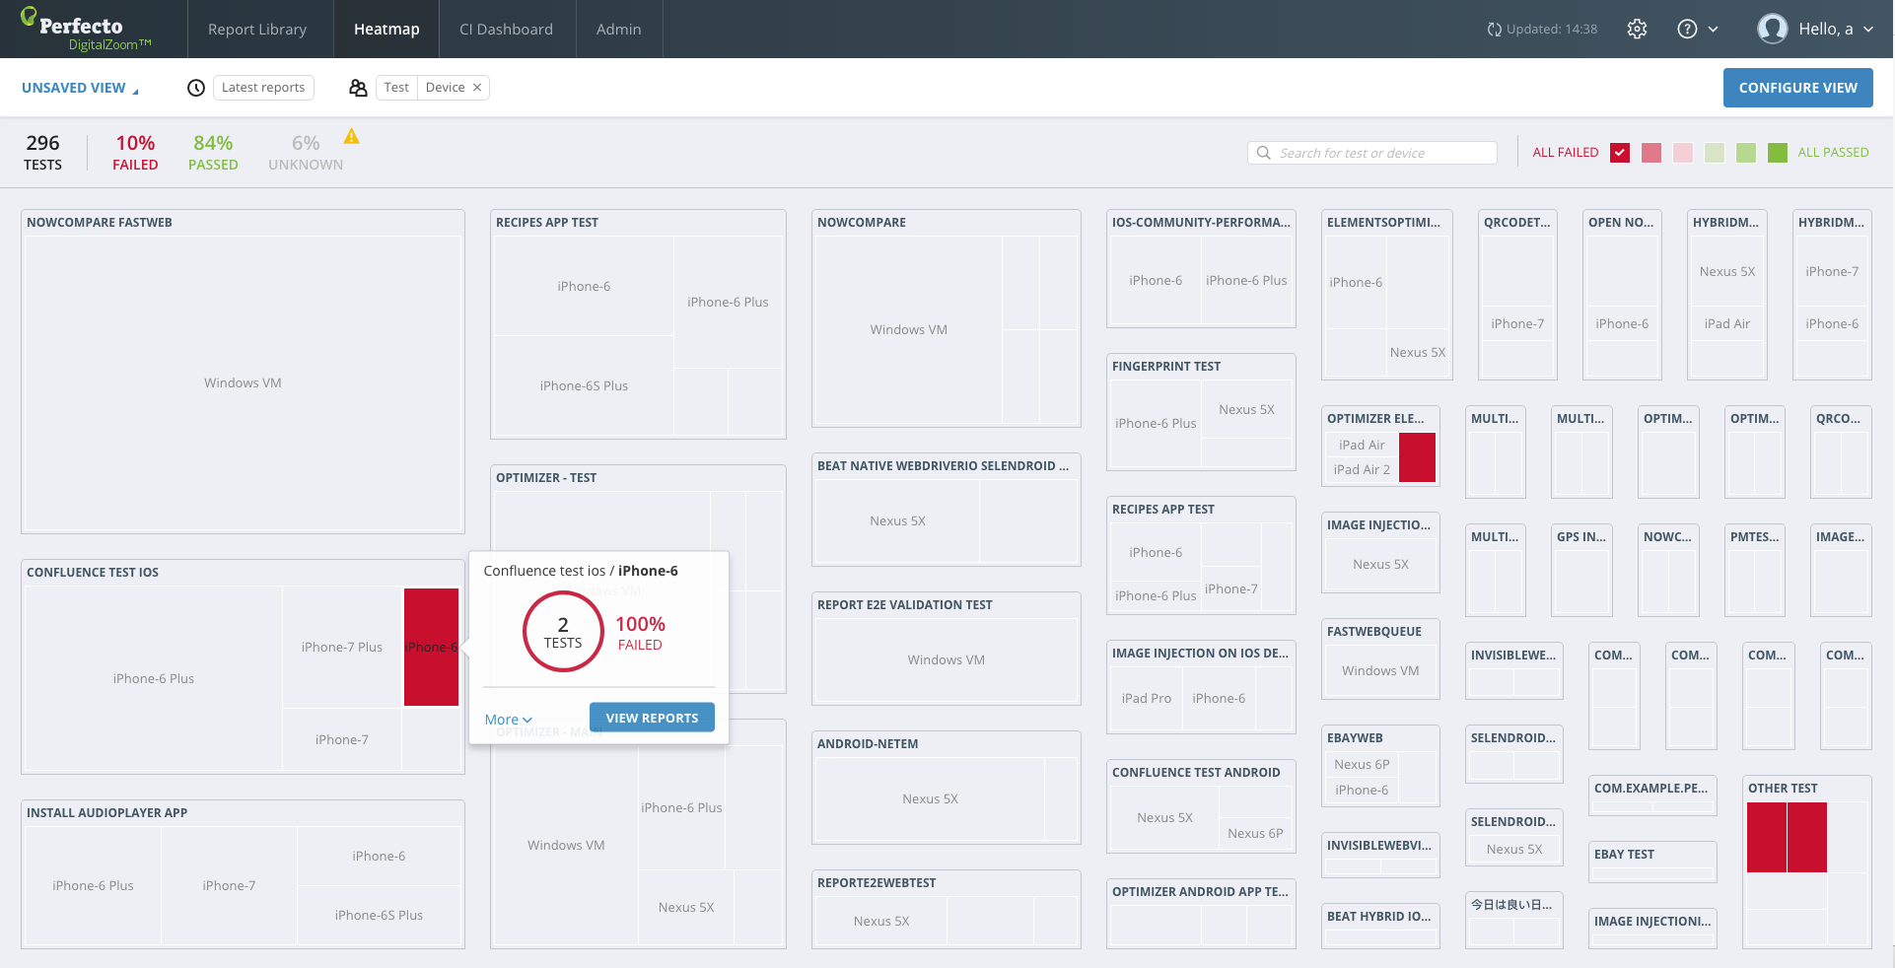
Heatmap Dashboard – filter to identify risk areas)
Notes:
Open the heatmap and display.

Slide 16
Live Stream
Displays real time video of scripts currently running
Allows you to see your code run live on a device

Slide 17
Tagging

Slide 18
Tagging
The reporting app works out of the box when you use Perfecto’s Quantum framework.
To improve results, use tagging
Tag each test in the feature file
Tag on the feature & scenario level
Multiple tags supported
Tags can be used as filters when viewing results

Slide 19
Questions

Slide 20
THANK YOU

